Slide 1


Simple solutions for complex problems
Oracle APEX Plug-ins by
Bartosz Ostrowski

Slide 2


Oracle APEX Plug-ins / Einstein never said that, but
„The definition of insanity is doing the same thing over and over again and expecting a different result.”
„The definition of insanity is implementing complex solution on multiple pages without wrapping it as a plug-in”

Slide 3
Pretius / 8 years of history
2012
2014
2015
2016
2016
2019
- Enhanced Column Attributes
- Client-Side Validation
- Enhanced LOV item
- Enhanced Modal Dialog
- Enhanced Notifications
- Nested Reports
- Date Range Picker
- Help Text Tooltip
- Enhanced LOV item 2
- APEX Context Menu
- APEX Competition
2020
Pretius start
Pretius stop

Slide 4
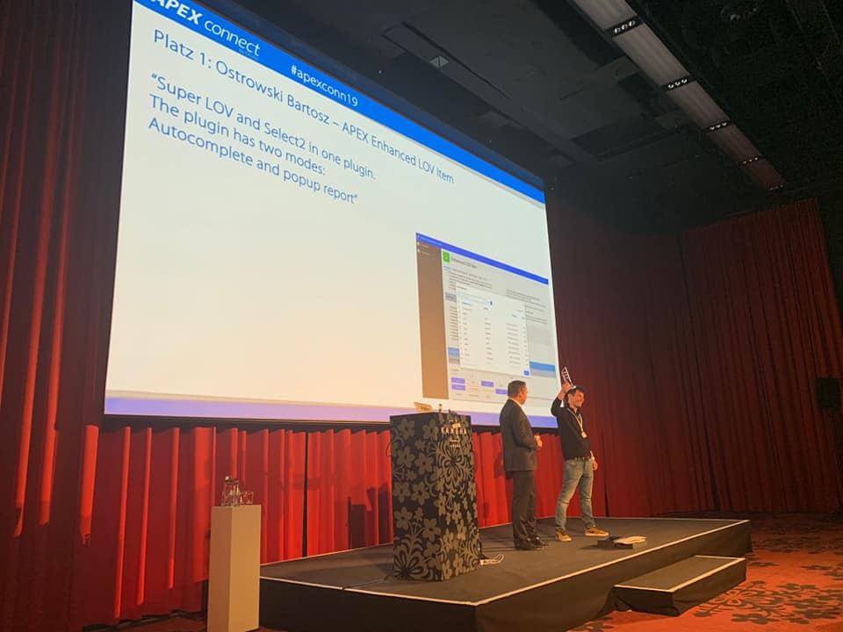

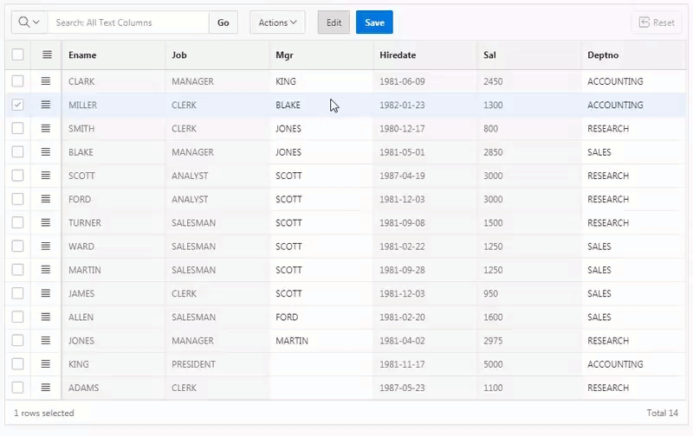
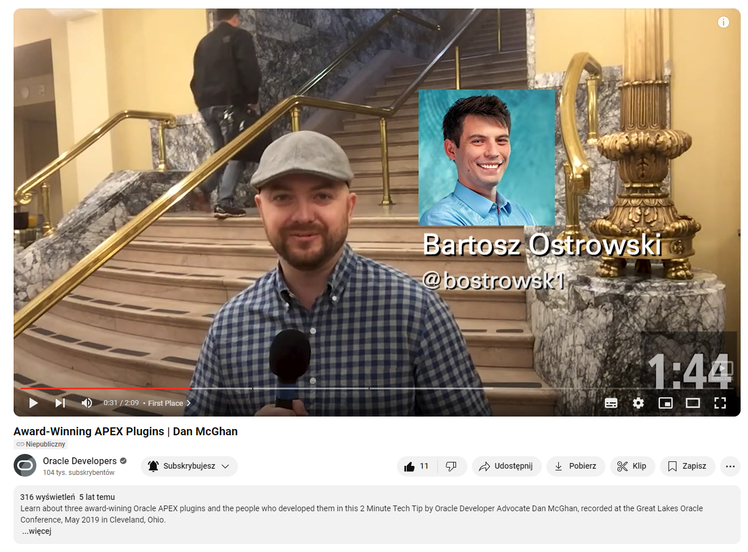
1st place / APEX COMPETITION @APEX CONNECT 2019
TBD
Source: https://youtu.be/CUk8_gC4DYs

Slide 5

United Codes / Commercial plug-ins
2020 Q1
2020 Q2
IG Checkbox Pro
2020 Q4
2021 Q2
2023 Q1
Guided Tour Pro
2021 Q2
Client Side Validation Pro
IG Download File Pro
2020 Q3
Interactive JET charts Pro
Rich Text Editor Pro
AOP Modal Download
APEX Office Edit

Slide 6
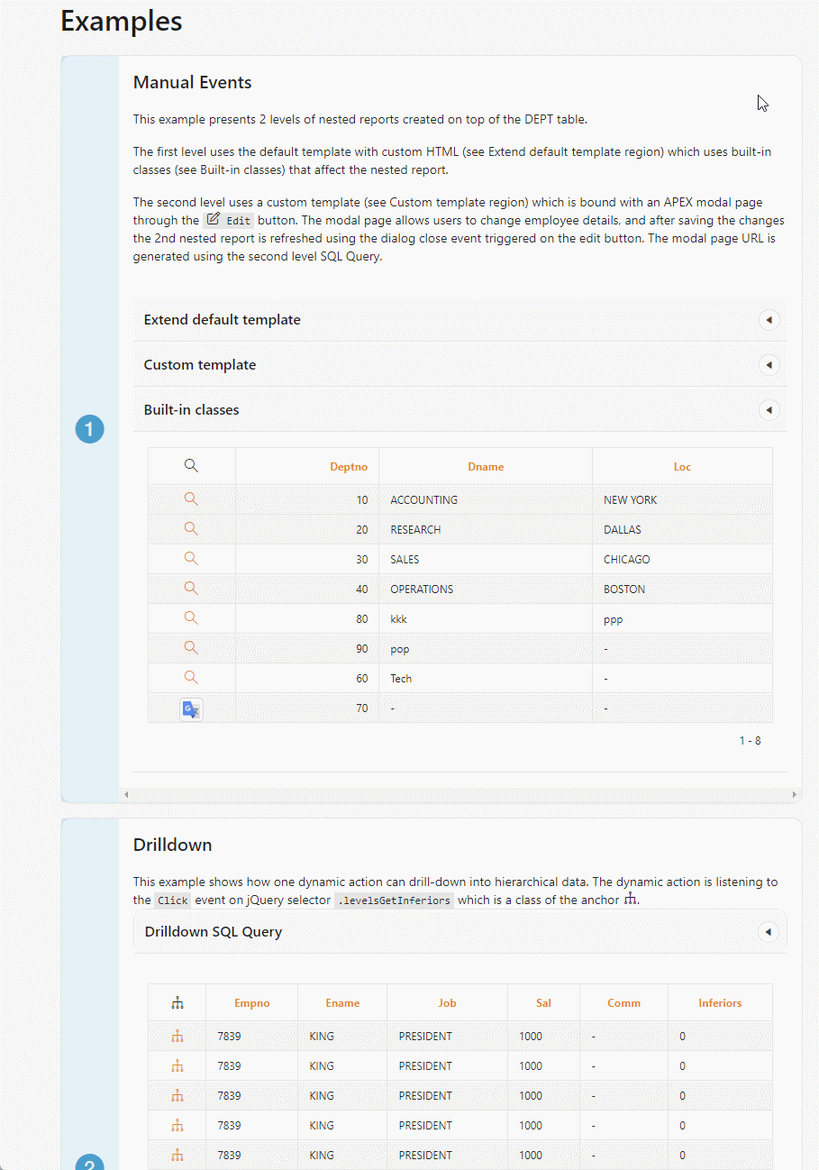

REQUIREMENTS/ NESTED REPORTs
„I want to click this row and get details. Can you do this?” -Przemysław Gołos
Default template - data presented in table
Custom template – iterate over fetched data and put into custom HTML
Custom callback – support custom JavaScript Code after fetching data

Slide 7
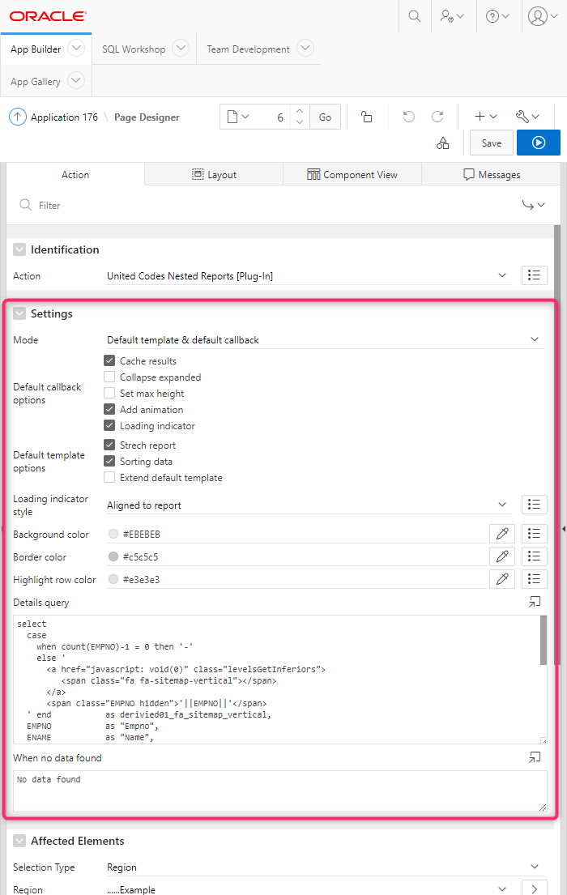
Statistics & INFO/ NESTED REPORTs
~1 300 JavaScript lines of code
~550 PL/SQL lines of code
~ 250 e-mails from around the world (outisde Pretius support)
39 stars on Github
Most liked and popular at apex.world
Used internally by Oracle employees

Slide 8
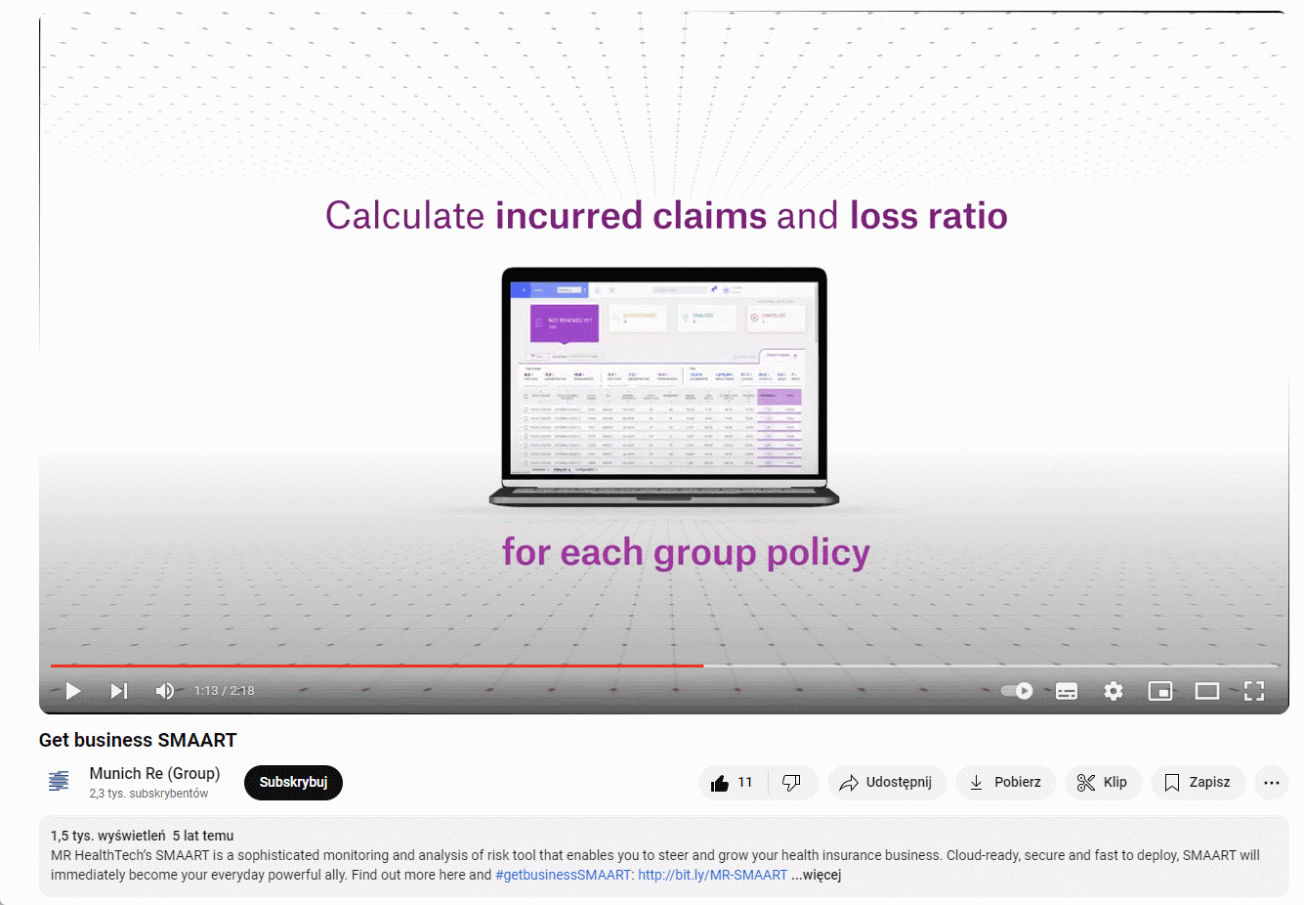
NESTED REPORTS: custom template + iframe/ MRHT SMAART
Source: http://youtu.be/S8W3hECXXuE

Slide 9
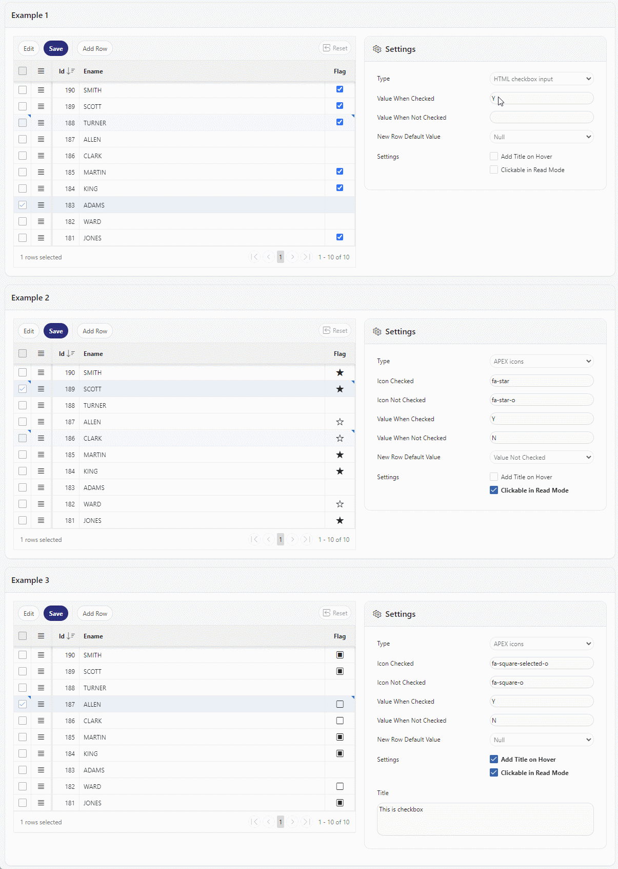
REQUIREMENTS/ IG checkbox PRO
Support for Oracle APEX 19.2 onwards
Support three checkbox states „Yes”, „No” and NULL value
Support custom icons instead of HTML checkbox
Enable checkbox interaction outside IG edit mode
Integrate using Interactive Grid JS APIs

Slide 10
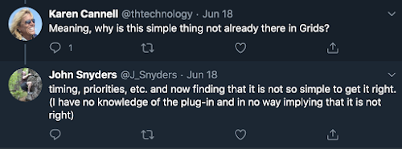
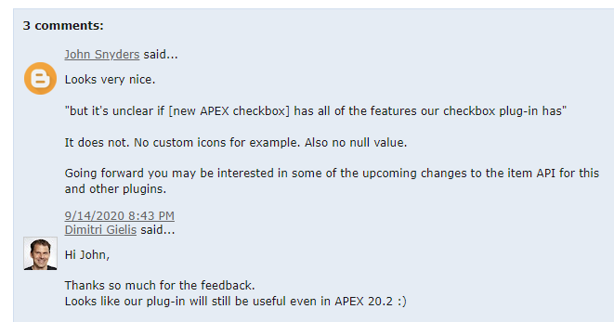
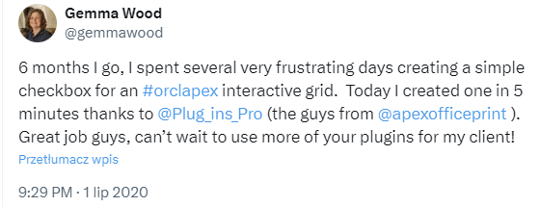
FUN FACTS/ IG checkbox PRO
Oracle introduced native component half year later for APEX 20.2
Today, the native component still doesn't support icons and three states of checkbox

Slide 11
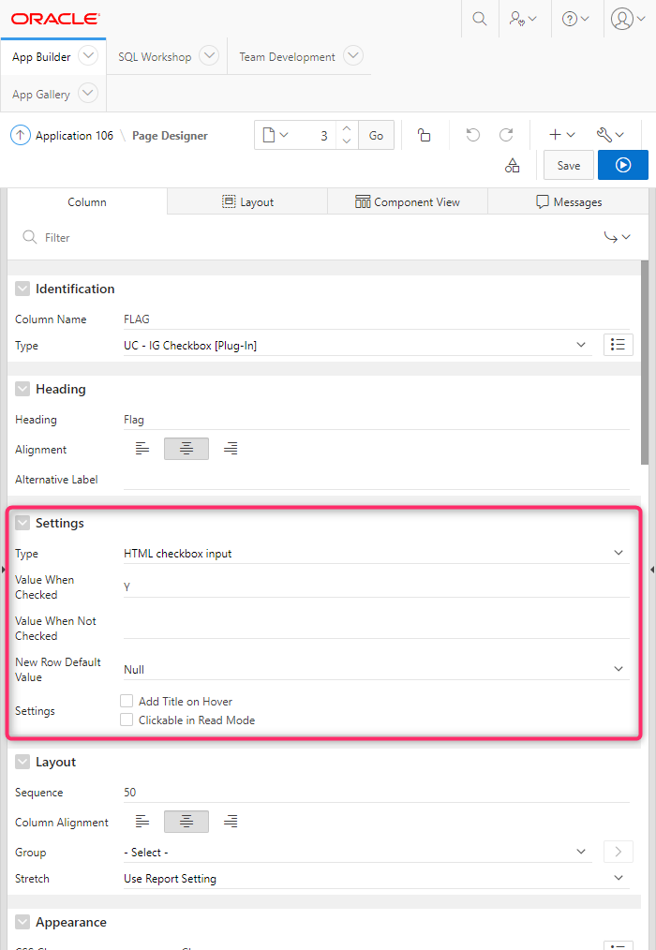
Statistics & INFO/ IG checkbox PRO
~100h
~1 300 JavaScript
~760 PL/SQL

Slide 12
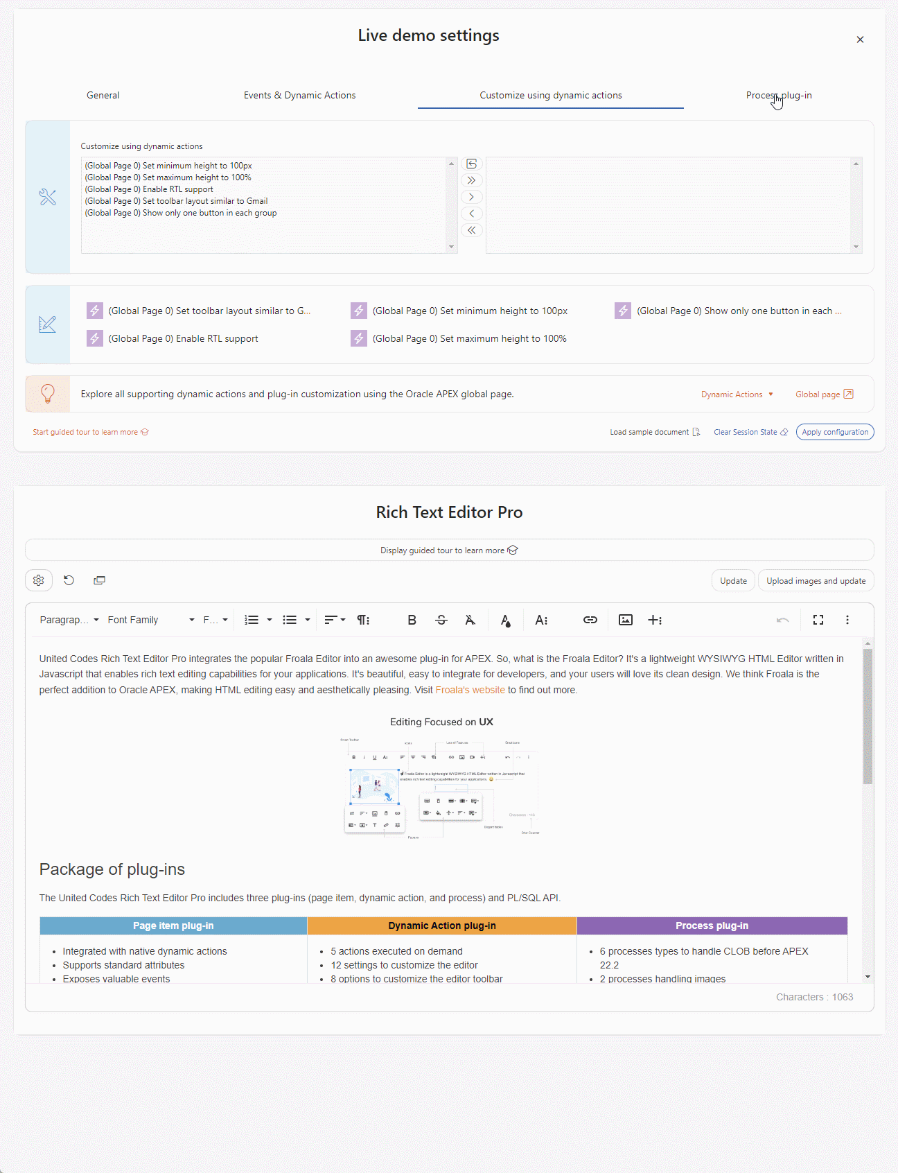
Requirements/ Rich Text Editor pro
Support CLOB values for APEX 19.2
Integrate with native components (forms)
Upload images on page submission
Dynamic Action configuration cross application pages (global page)
Deleting images in database after removing from rich text document

Slide 13
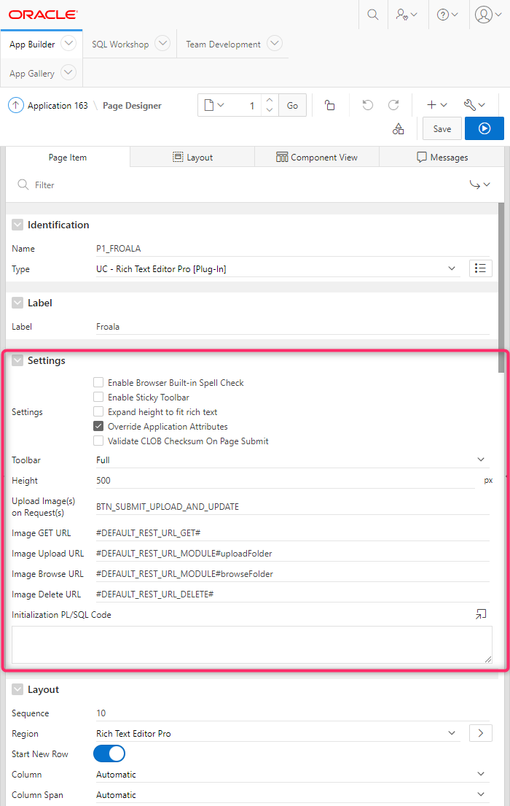
Statistics & INFO/ Rich Text Editor pro
Page item plug-in
2 500 h
15 000 lines in JavaScript
10 000 lines in PL/SQL

Slide 14
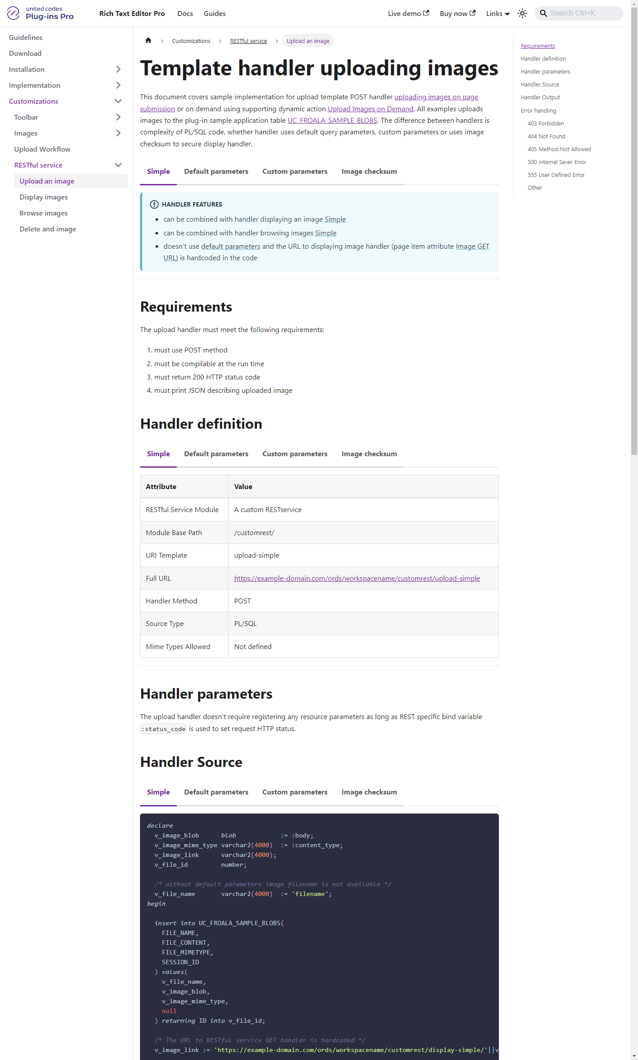
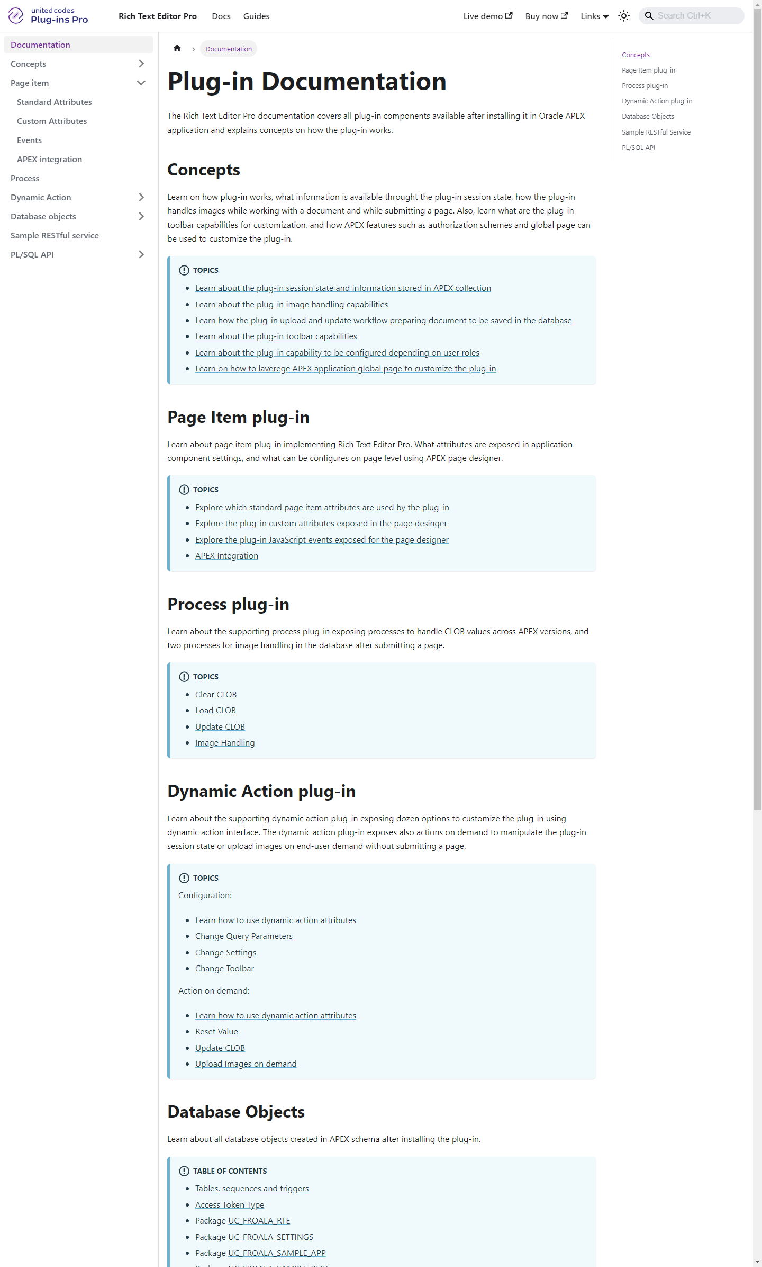
Statistics & INFO/ Rich Text Editor pro
~100 documentation pages
Concepts behind plug-in explained
Step by step guiliness
Code examples ready to copy

Slide 15
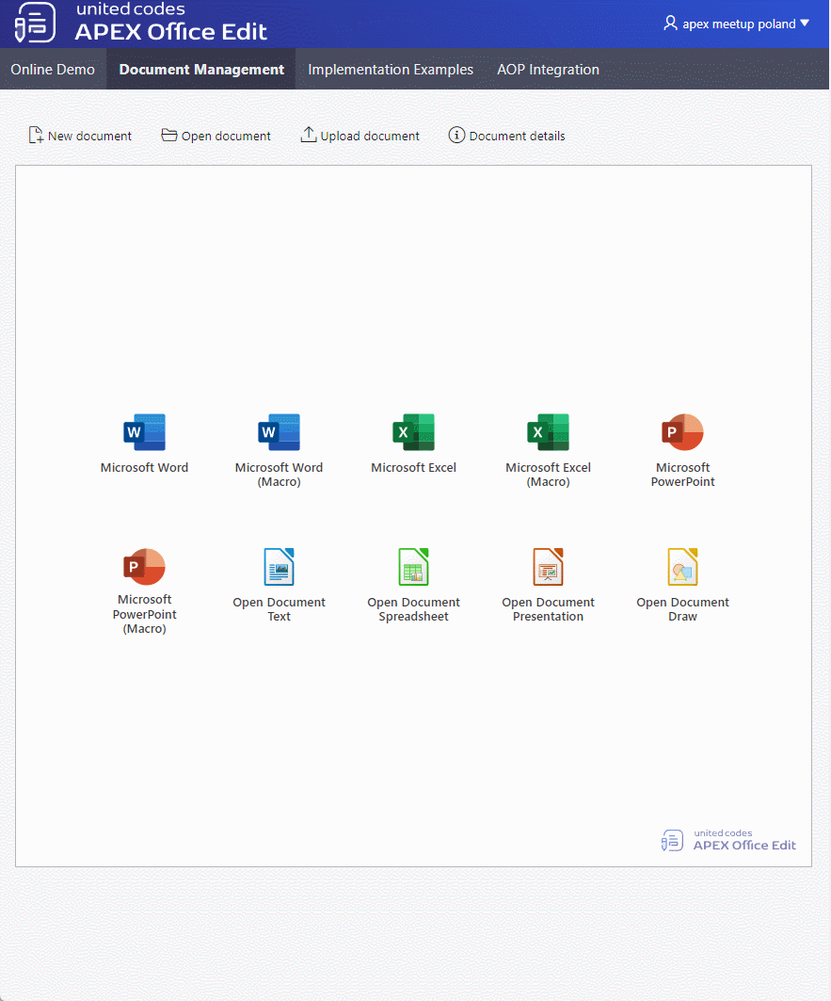
Requirements/ APEX Office EDIT
Integrate Libre Office
Handle communication between APEX – ORDS – AOE server
File BLOB processing based on custom table definition
File BLOB processing using develope’s PL/SQL code

Slide 16
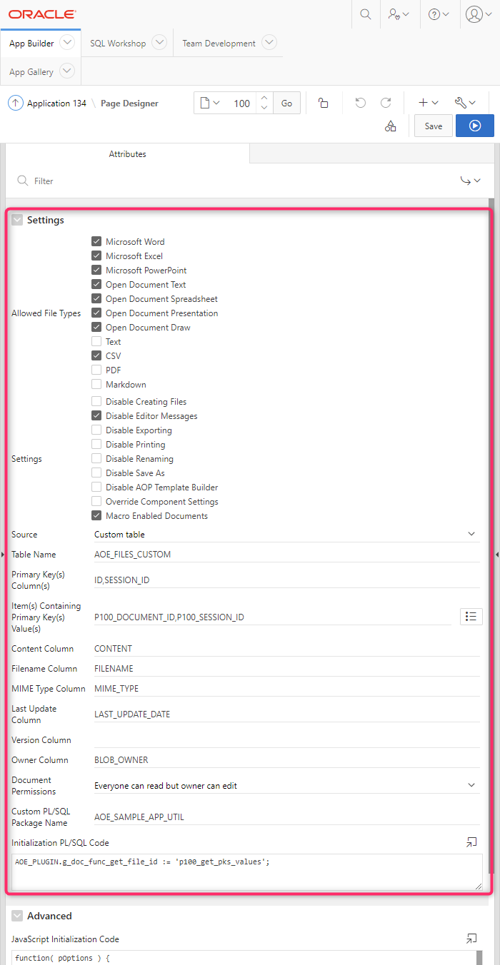
Statistics & INFO/ APEX Office EDIT
Region plug-in
Allows editing MS documents in APEX
~1 200 h
~15 100 JavaScript
~11 500 PL/SQL

Slide 17
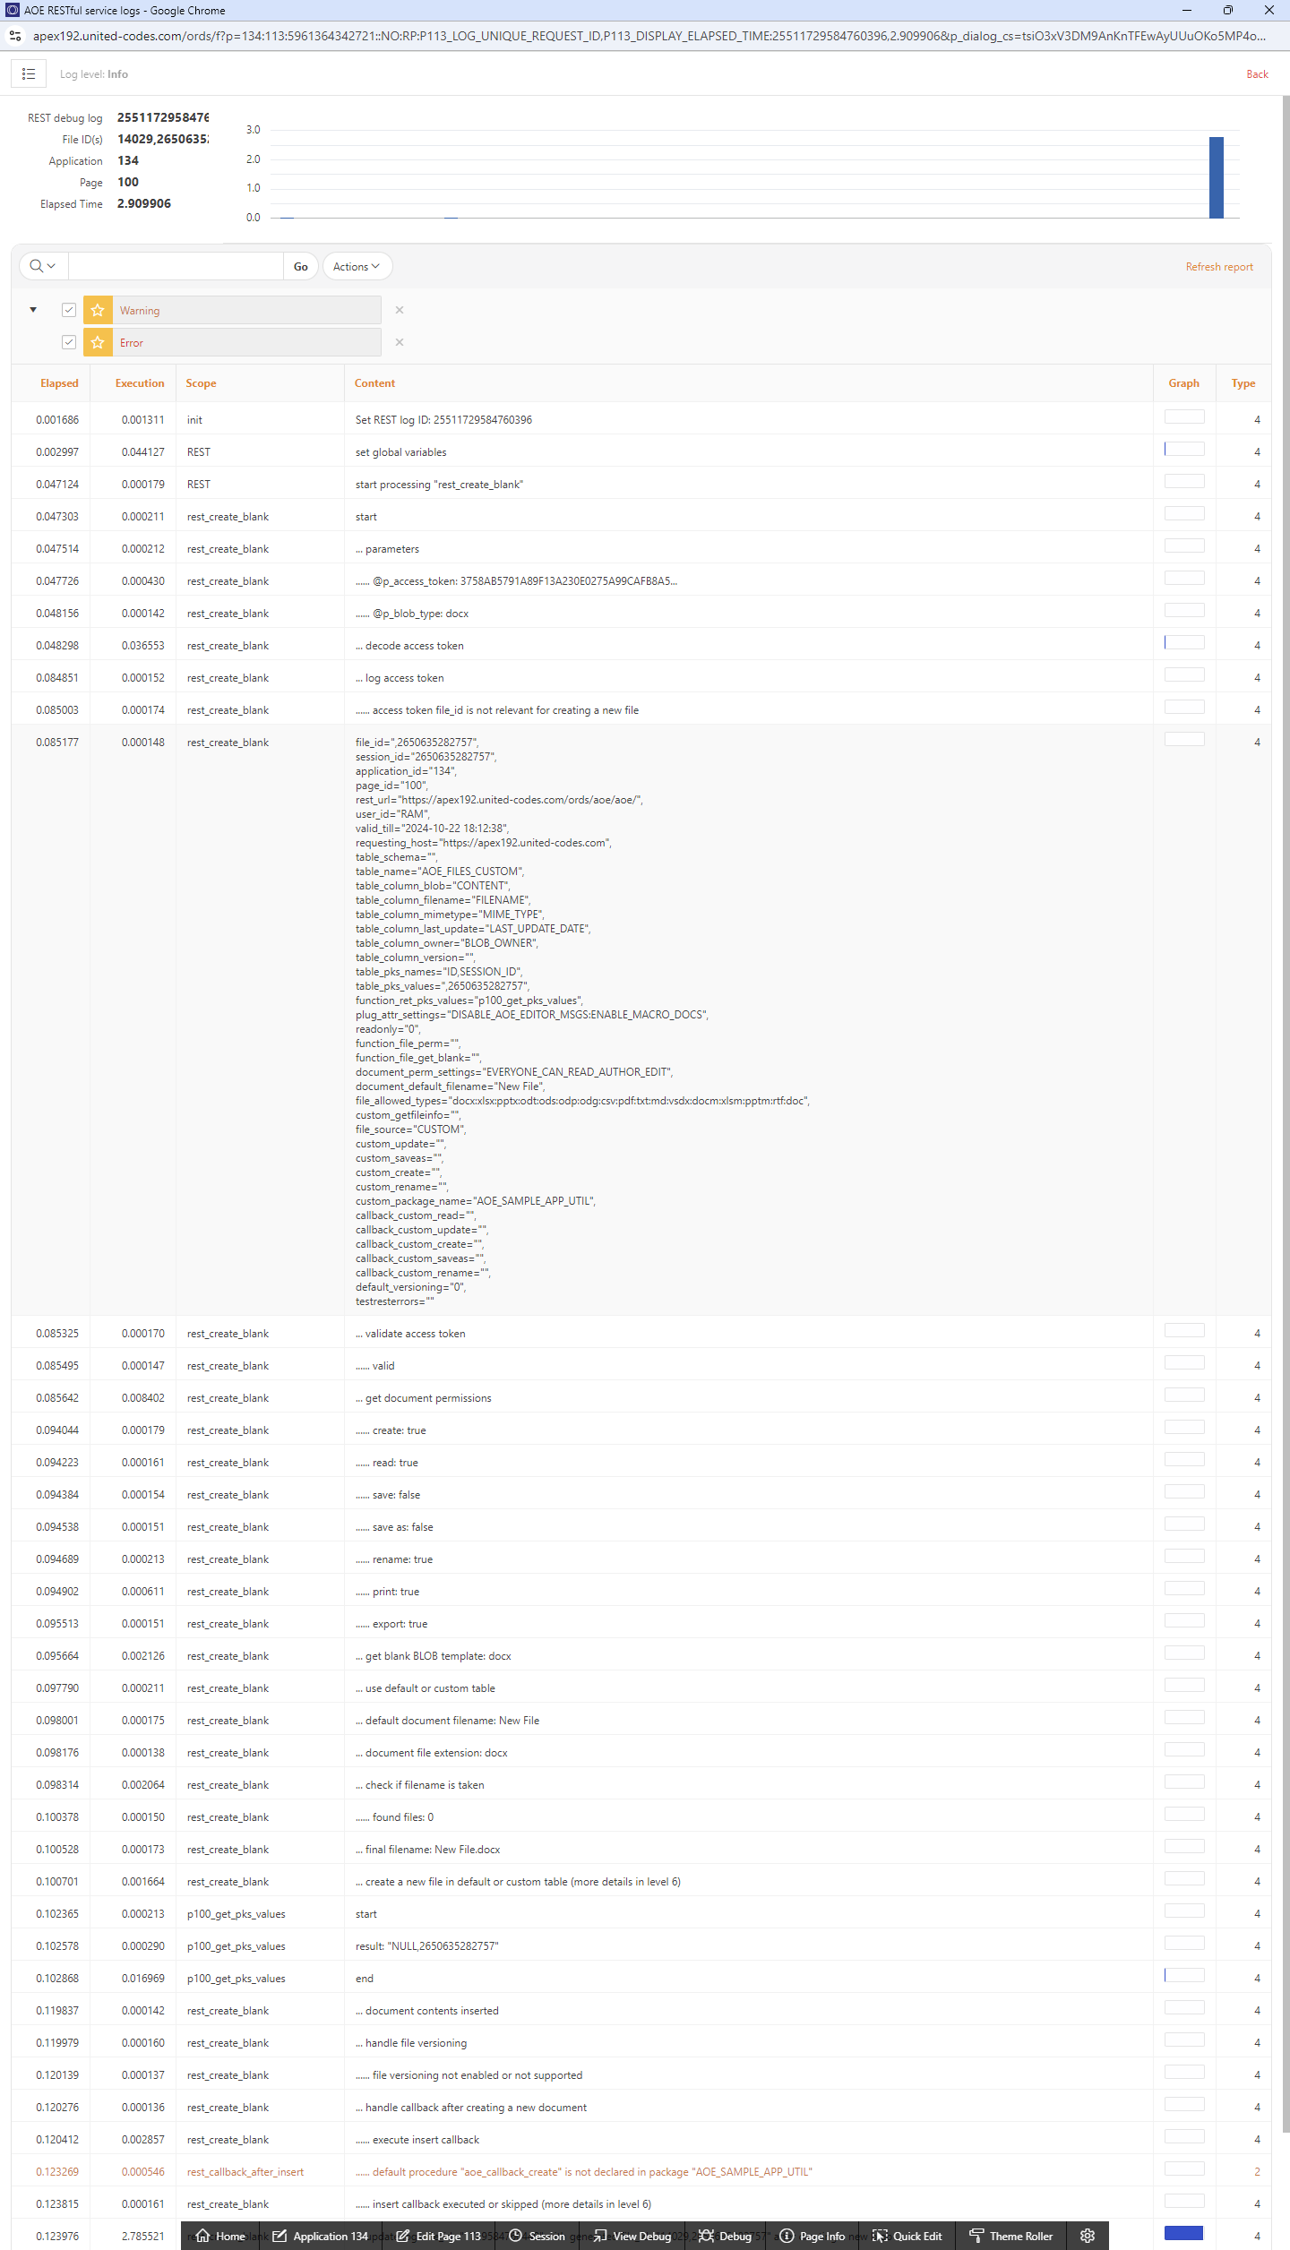
Fun facts/ APEX Office EDIT
Don’t build your own debug message for ORDS RESTful handlers
Debug messages must be „saved” „apex_session.detach;”

Slide 18
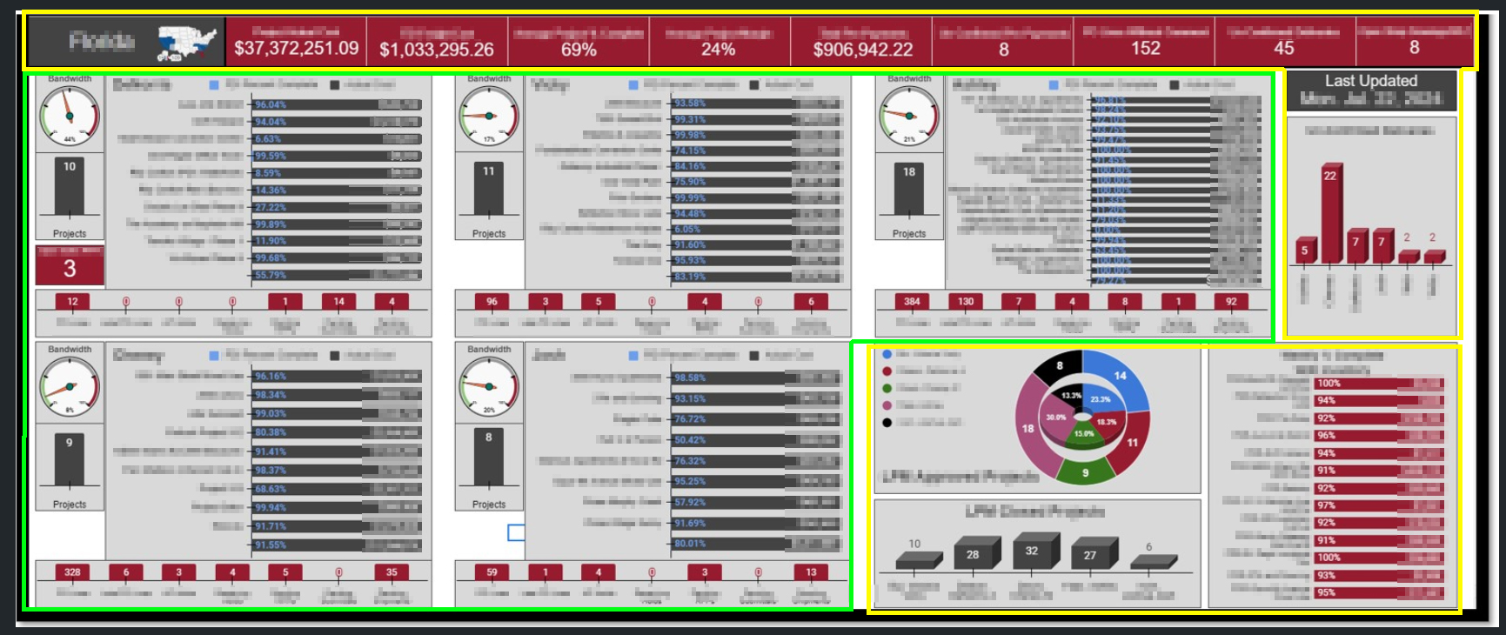
REQUIREMENTS/ Dynamic dashboard
Region number depends on data in the database
Static components

Slide 19
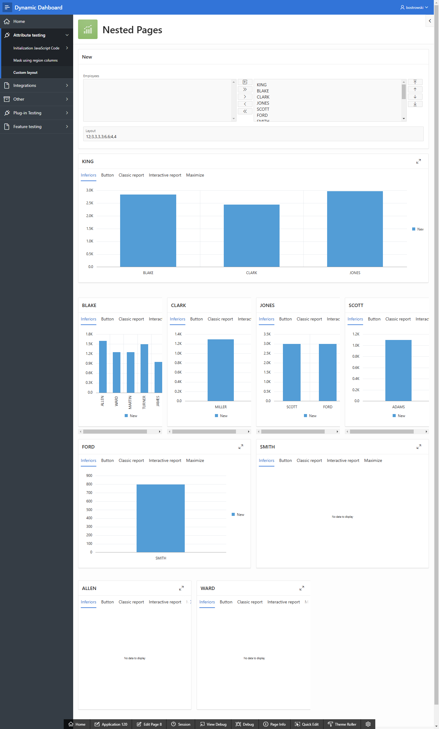
work in progresss/ Dynamic dashboarD demo
Data driven dashboard using APEX pages
Native components support
Citizen Development
Dynamic layout using APEX 12 column grid
ACL support

Slide 20
END/ LAST THOUGHTS
JavaScript and PL/SQL debug messages are your friend
Explore APEX internals yourself (tables, views, APIs)
Learn from work of other developers (plug-ins at apex.world)
APEX community will help you at twitter / apex.world slack

Slide 21
Thank you for your time
Twitter: @bostrowsk1 E-mail: bartosz@united-codes.com
E-mail: ostrowski.bartosz@gmal.com

